Slide 1
Autonomous Navigation and Path Planning using (RL)
CB.SC.U4AIE23261 - VAISHNAVI JSS

Slide 2
ABSTRACT
This project develops a reinforcement learning-based navigation system for autonomous robots in dynamic environments. Using Deep Q-Networks (DQN) or Proximal Policy Optimization (PPO), the robot continuously learns and improves its ability to avoid obstacles and find the best path. The approach enhances safety and efficiency in real-world applications like warehouse automation and smart transportation..

Slide 3
INTRODUCTION
Autonomous robots face challenges in navigating dynamic environments with moving obstacles. Traditional path planning methods struggle with unpredictability, making real-time decision-making difficult. This project uses reinforcement learning to help robots learn adaptive path planning for safer and more efficient navigation.

Slide 4
PROBLEM STATEMENT
Optimizing Autonomous Robot Navigation in Dynamic Environments Using Reinforcement Learning for Adaptive Path Planning and Obstacle Avoidance.

Slide 5
METHODOLOGY
STEP-1
Identify key challenges:
Handling dynamic obstacles (moving objects).
Dealing with sensor noise (LiDAR, cameras).
Ensuring real-time path planning.

Slide 6


STEP-2 Define the Reinforcement Learning Framework
State Representation (S):
Robot’s position (x, y, θ).
Robot’s velocity v.
Detected obstacle positions from LiDAR/camera.
Distance to the goal.
Sensor readings (for environment awareness).
Action Space (A):
Move forward/backward:
Turn left/right:

Slide 7

Reward Function (R):
Positive reward for moving toward the goal.
Penalty for colliding with obstacles.
Penalty for inefficient paths (extra turns).
Energy cost included to encourage efficient movement

Slide 8
STEP-3 Select Reinforcement Learning Algorithm
Deep Q-Network (DQN): If action space is discrete.
Proximal Policy Optimization (PPO): If action space is continuous.
Soft Actor-Critic (SAC): If we need more robust exploration

Slide 9

STEP-4 Training Process
Initialize the robot in a virtual environment.
Sense the environment using LiDAR/camera.
Select an action using the RL policy
Move the robot based on the chosen action.
Observe the new state and calculate the reward.
Update the RL model using policy optimization techniques.
Repeat steps 3-6 for multiple episodes until convergence

Slide 10
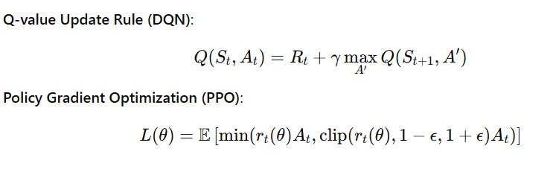
STEP-5 Optimization Using RL Formulations

Slide 11
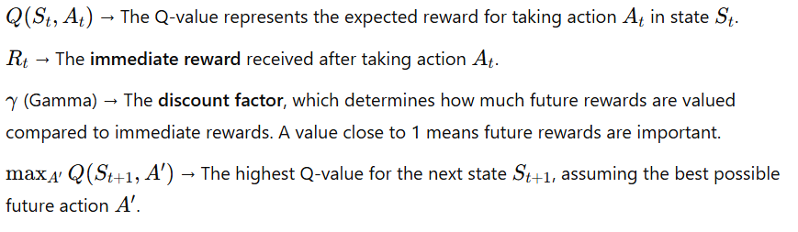
Q-Value Update Rule (DQN)

Slide 12
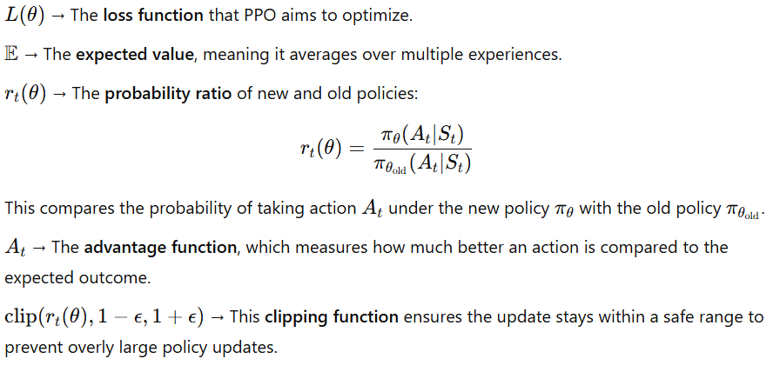
Policy Gradient Optimization (PPO)

Slide 13
STEP-6 Performance Evaluation Metrics
Success Rate: Percentage of successful goal-reaching attempts.
Path Efficiency: Distance traveled vs. optimal path.
Collision Rate: Number of obstacle collisions per episode.
Computational Efficiency: Time taken for real-time decisions.

Slide 14
STEP-7 Deployment and Testing
Test in a simulated environment (Gazebo, ROS).
Fine-tune RL model based on real-world sensor data.
Deploy in real-world robots for practical validation.
Iterate based on testing feedback.

Slide 15
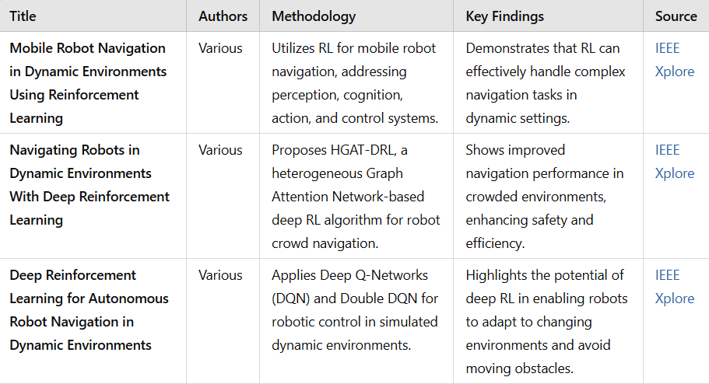
LITERATURE REVIEW

Slide 16
CONCLUSION
Reinforcement learning enables robots to navigate dynamic environments efficiently while avoiding obstacles. By learning from experience, the system continuously improves its decision-making capabilities. This approach ensures safer and smarter navigation in various real-world applications.

